Slide 1
KV Cnc : an RR Lyrae with Irregular Blazhko Effect
P. de Ponthière, M. Bonnardeau, F-J. Hambsch, T. Krajci ,
K. Menzies, R. Sabo
AAVSO Fall Meeting 2013 - Woburn

Slide 2
RR Lyrae (RRab) in a nutshell
Pulsating stars
  Periods: 0.3 to 0.8 days
Some with Blazhko effect
  Amplitude and phase modulation
  Blazhko periods: 10 to 1000 days
Some with multiple Blazhko modulations
  Modulations in resonance or not
Blazhko effect: frequently irregular

Slide 3
KV Cnc observation challenges
Pulsation period 0.50208 day (12hr + 3min)
  Maxima delayed by 6 min / day
Observation time windows for a particular site
Multi-longitude campaign
  Belgium, France
  Framingham MA
  Cloudcroft NM (AAVSONet W28)
  Bozeman MT

Slide 4
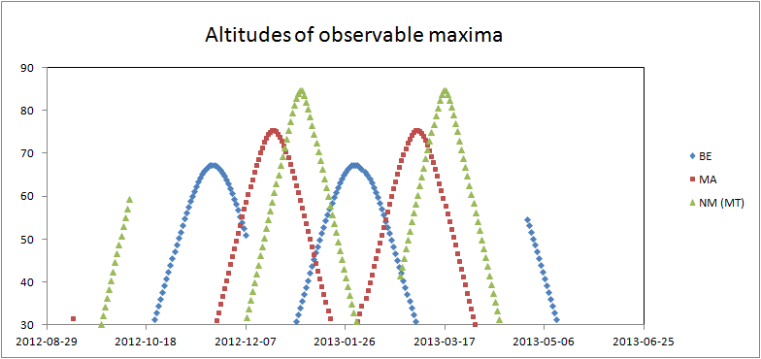
Observation time windows
Local horizons (trees) not used in this graph except for Belgium
Notes:
Each window begins in the evening and end in the morning
For Belgium (Lesve), the local horizon has been used.

Slide 5
KV Cnc observation campaign
Two observation seasons
  January 2012 to May 2012
  October 2012 to May 2013
    158 observation nights
    Total time span 480 days
32,280 light curve data points
92 pulsation maxima recorded
  (O-C)
  Magnitude at maximum

Slide 6
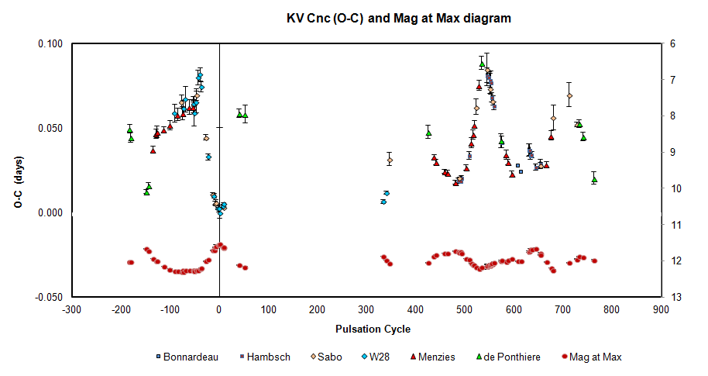
(O-C) and Magnitude at Maximum

Slide 7
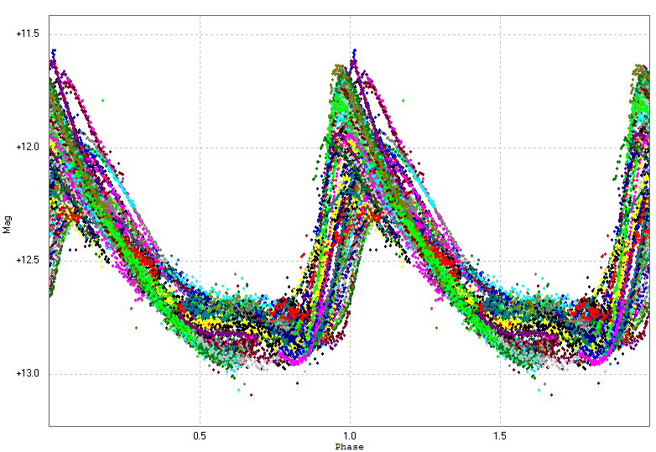
Maxima analysis
Linear regression of the (O-C) values
  Pulsation period of 0.50208 day
Folded light curve

Slide 8
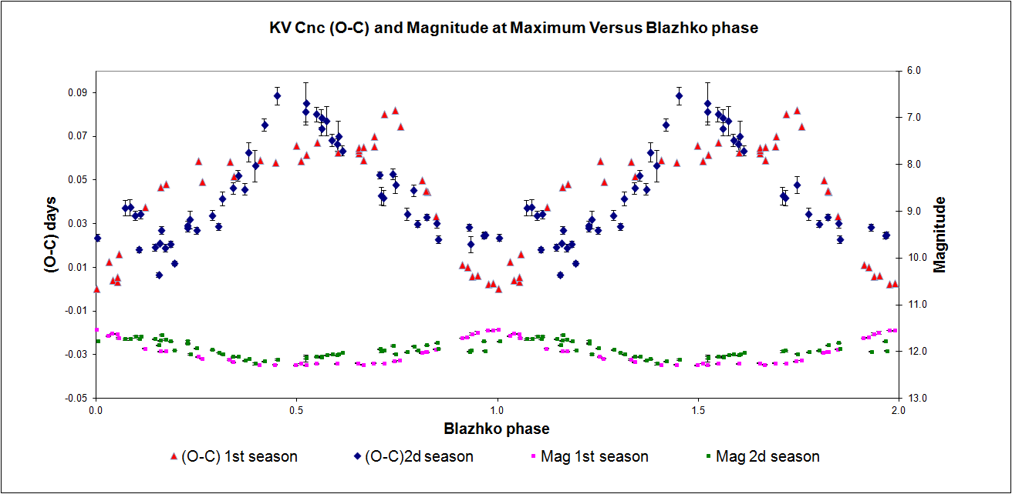
Maxima spectral analysis
Period04 : (O-C) and Mmax
  Main Blazhko period 77.6 d
  Secondary Blazhko period 40.5 d

Slide 9
Folded light curves for different
Blazhko phases
Astonishing slope in ascending branch : 2.5 mag / hour

Slide 10
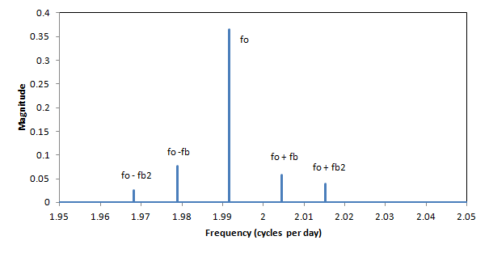
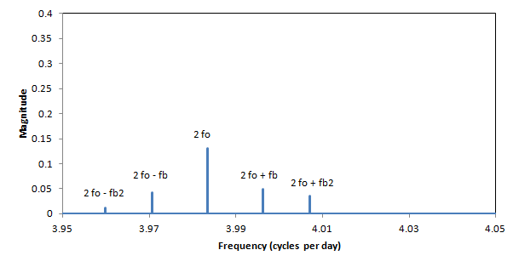
Light curve spectral analysis
Triplets as ( n f_{o} ± f_{x} )
detected for f_{b} and f_{b2}
f_{o} = 1.99169 d⁻¹ (0.50209 d)
f_{b} = 0.01285 d⁻¹ (77.8 d)
f_{b2} = 0.02359 d⁻¹ (42.4 d)
  Mag at maximum analysis
    → 40.5 d
  42 d from Northern Sky Survey
    P.Wils et al.
  Why didn’t they detect f_{b}??
f_{b2} statistically
not a harmonic of f_{b}
Quintuplets as ( n f_{o} ± 2 f_{b} )
were not detected

Slide 11
Conclusions
RRab Blazhko characterisation needs
  Time series over long time span
  Multi-longitude observations
RR Lyrae with Blazhko effect behave differently
  Plenty of surprises
  Not boring stars
Other RR Lyrae campaigns are running
  Don’ t hesitate to join the group

